Slide 1
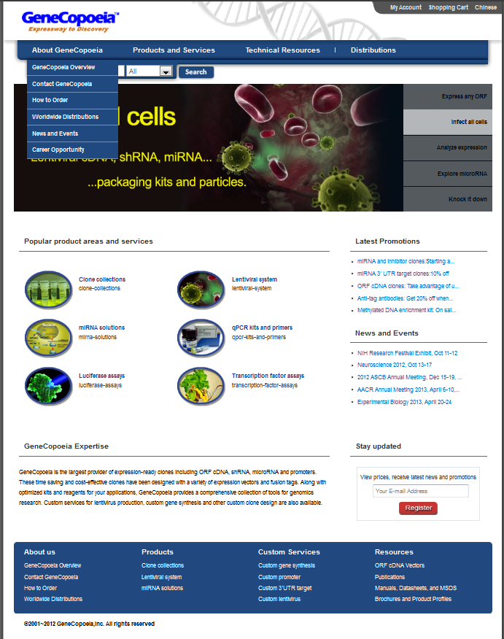
Rename ‘How to Order’ to Order Support
Rename ‘How to Order’ to Order Support

Slide 2
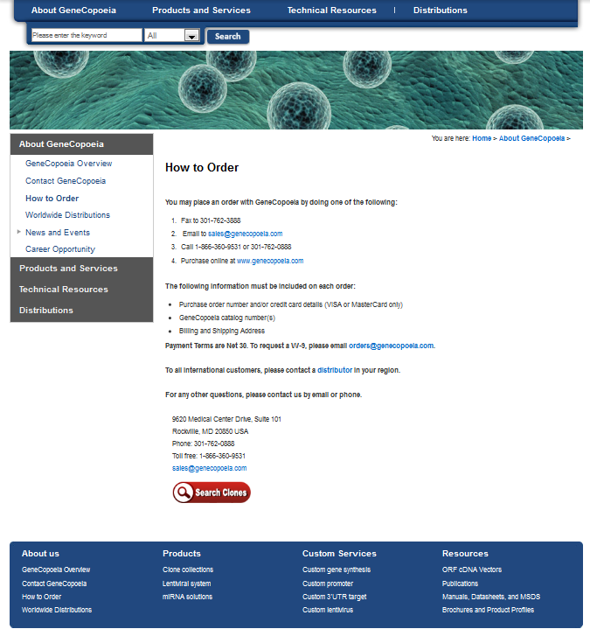

How to Order
You may place an order with GeneCopoeia by doing one of the following:
1) Fax to 301-762-3888
2) Email to sales@genecopoeia.com
3) Call 1-866-360-9531 or 301-762-0888
4) Purchase online at www.genecopoeia.com
The following information must be included on each order:
· Purchase order number and/or credit card details (VISA or MasterCard only)
· GeneCopoeia catalog number(s)
· Billing and Shipping Address
To all international customers, please contact a distributor in your region. Direct orders are only allowed upon agreement by GeneCopoeia .
Order Status
To request order status, please email orders@genecopoeia.com. Or you may complete the short form here.
Accounting
To request a W-9 form, Vendor Application, a copy of a Sales Order or Invoice, or any other accounting-related inquiries, please call 301-762-0888, option 2.
Order Support
See next page for instructions.

Slide 3
SC- Please create a new Landing Page for order status requests.
When a customer completes the form, it should then be forwarded to ‘orders@genecopoeia.com’.
Request for Order Status
Please complete the short form below and we will email order status within 24 hours.
*Required fields
Name : | *
Institution : | *
Email : | *
Catalog # (s): | *
Sales Order No. and/or PO#:
Additional Comments:
Submit

Slide 4
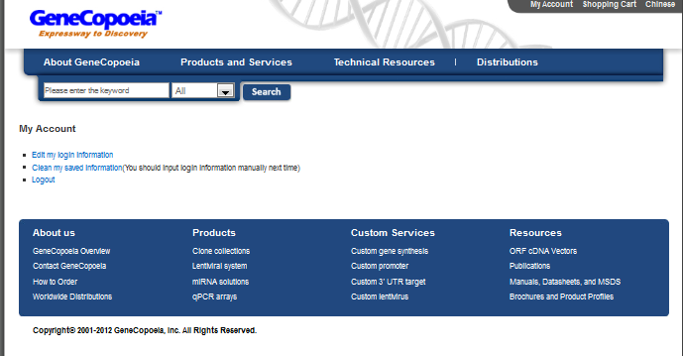
http://www.genecopeia.com/login/account.php
Add:
Request Order Status
‘Request Order Status’ should be directed to the Landing Page for order status requests (slide 3).

